Slide 1
Online Assembly VE day, 8th May

Slide 2
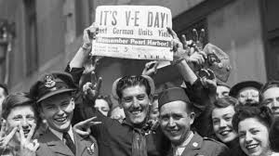
What is VE Day?
V-E Day was observed on May 8, 1945 in Great Britain, Western Europe, the United States and Australia, and on May 9 in the Soviet Union and New Zealand. V-E Day commemorates the unconditional surrender of Nazi Germany to the Allied forces in 1945, ending World War II in Europe

Slide 3
Why should we remember?
To remember the sacrifices people made during the Second World War and to recognise that great sacrifice comes to an end and we can celebrate.
At this time of sacrifice caused by the coronavirus pandemic we can recognise that the sacrifices we are making are saving lives and that we will get through this and be able to celebrate together in the future.

Slide 4
Video
Please watch this video – try and do this with others in your house.
https://www.youtube.com/watch?v=_-CdpqhxDR8
Remember,
The war lasted 6 years
Rationing (limits on food and other items) lasted for many more years
Groups were deliberately targeted and murdered across Europe
Parts of the country had been targeted by bombing
Children were sent away from their parents through ‘evacuation’

Slide 5
Questions
During the coronavirus pandemic families have been affected by loss. Over 29,000 people have died.
Please consider the questions below, do this with a family member if possible –
Compare our sacrifice at this time with those in 1939-45. What are the differences, what are the similarities?
How will we celebrate when this is over? Will there be similarities with the celebrations you saw in the video?
How will we remember 2020 and those lost in the pandemic?

Slide 6
